Slide 1
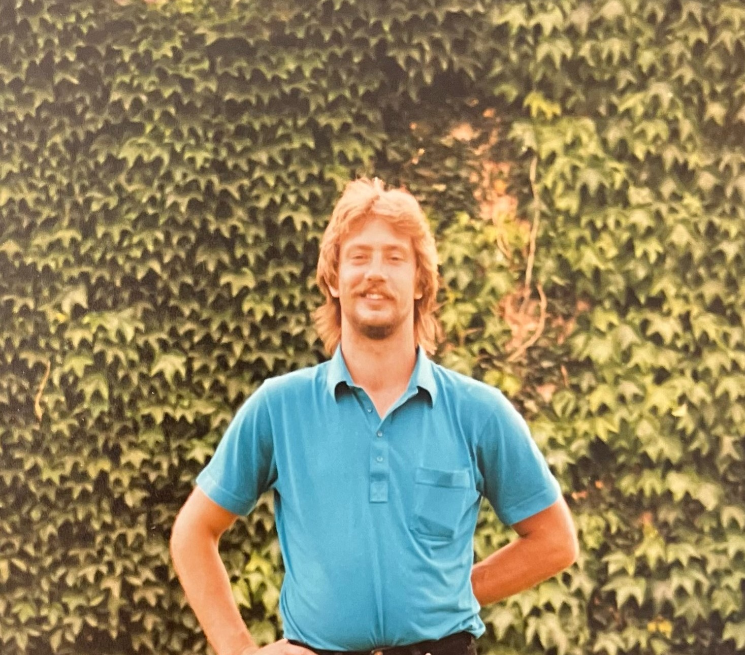
Join family and friends in
Celebrating the life of
CRAIG VAN DIETEN
Feb 7, 1961 – July 26, 2024
Sunday, August 18, 2024 (1-4 PM)
Old Pelham Town Hall
491 Canboro Rd.
Pelham, ON
L0S 1C0
We would love for you to join us and welcome you to
share your stories and favorite memories of Craig. If you would like to attend virtually or have any questions. please contact Marilyn at mvandieten@gmail.com

